Slide 1

Path Planning via BMC and Hyper-Properties
B-23-2-R-5
Daniel Belaish
Liron Lavi
Supervisor
Dr. Sarai Sheinvald

Slide 2
Table of contents
01
04
02
05
Problem Overview
Algorithm
Path Planning in a dynamic environment
Formula generation and BMC
Background
Analysis and Benchmarking
System, SAT, Kripke Structures and Occupancy Indicators
Test Results, Complexity
Data Processing
03
The Data Pipeline

Slide 3
01
Problem Overview

Slide 4

Problem Overview
Path planning is a fundamental problem in robotics and computer science, involving finding an optimal path from a start point to a goal point while avoiding obstacles.
Key Components of Path Planning:
Map Representation
Collision Avoidance
Search Algorithm
Cost Function

Slide 5
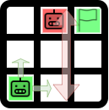
Problem Overview
Environment – 2D Grid with start point and final point
Obstacles – Any number of counter-agents roaming the grid.
Rules – Single step at a time, synchronized steps for all agents. Each agent can move up, down, right, left or stay.
Collision – primary agent occupies the same cell as the counter-agent.

Slide 6
02
Background

Slide 7
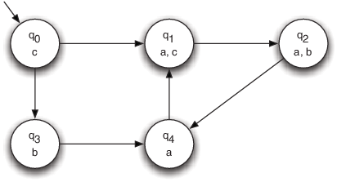
Background
Kripke structures are mathematical models used in modal logic to represent possible worlds and the relationships between them.
Kripke Structures consists of
States
Transition Relation
Labels
Kripke Structures allow us to model the behavior of the agent or counter-agents system.

Slide 8
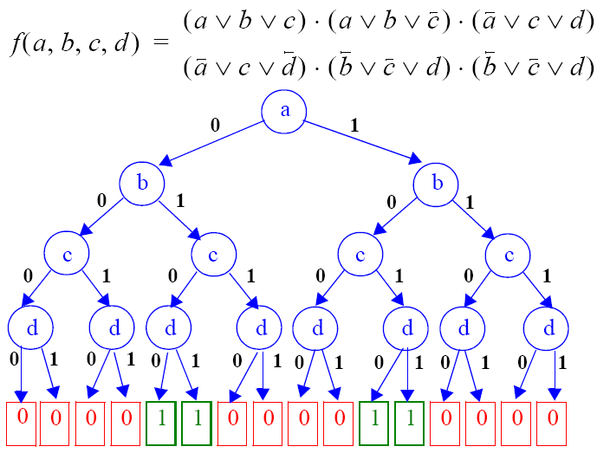
Background
The Boolean Satisfiability Problem (SAT) asks whether a given logical expression can be made true by assigning values to its variables.
It's NP-complete, meaning no known polynomial-time algorithm can solve all instances efficiently, but solutions can be verified in polynomial time.
The Input is a Boolean formula
The output is a satisfying assignment (if exists)

Slide 9

Background
Definition: SAT solvers are algorithms designed to solve instances of the Boolean Satisfiability Problem (SAT).
Functionality: These solvers employ efficient search techniques to determine whether a given Boolean formula is satisfiable or unsatisfiable.
Utilize heuristics and optimization strategies such as conflict-driven clause learning (CDCL) and backtracking.
In our project we use the notable Z3 Solver.

Slide 10
03
Data Processing

Slide 11
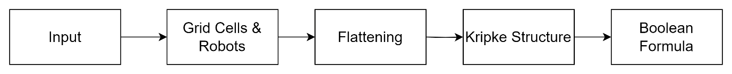
Data Processing
Input: Initial stage accepting system specifications, including grid dimensions, robot configurations, and relevant parameters.
Grid Cells and Robots: System architecture abstracted into a structured representation, identifying grid cells and robot presence within each cell.
Flattening: Evolving system dynamics distilled into a temporal sequence of snapshots while flattening counter-agents to occupancy indicators.
Kripke Structure: Transition to a formal representation via construction of a Kripke structure, capturing system evolution over time with discrete nodes and transitions.
Boolean Formula: Encoding system dynamics, constraints, and objectives into a logical Boolean formula for rigorous analysis and solution derivation using automated solvers.

Slide 12
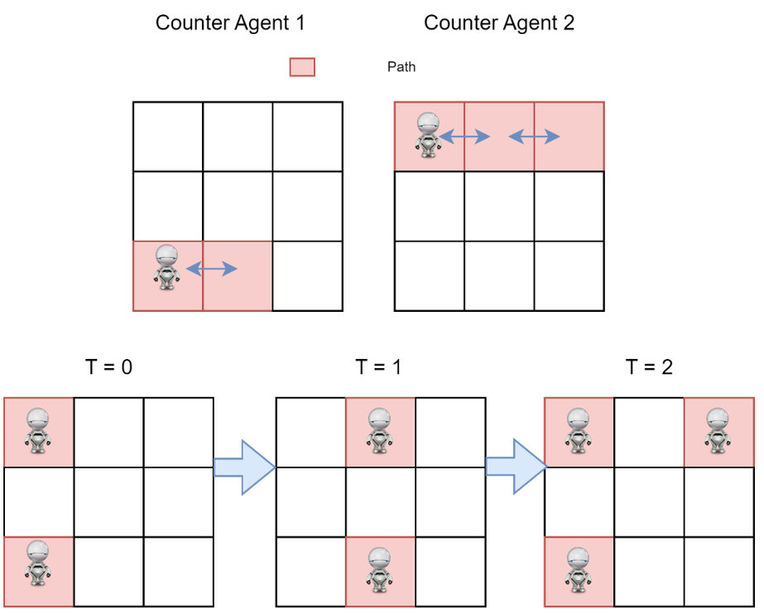
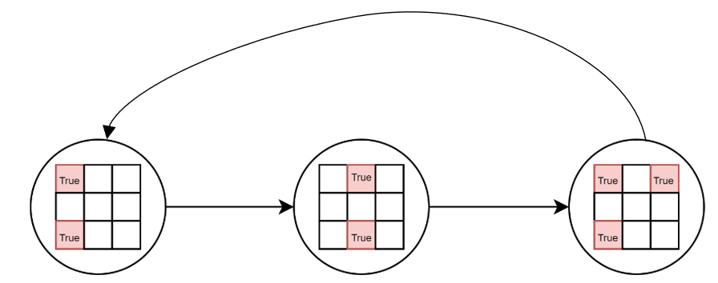
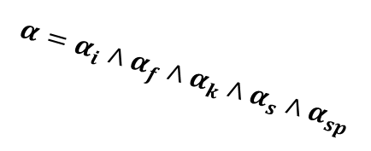
Data Processing
Input
Grid Cells & Robots
Flattening
$$α=α_{i}∧α_{f}∧α_{k}∧α_{s}∧α_{sp}$$
Path
Boolean Formula
Kripke Structure

Slide 13
Demonstration

Slide 14
04
Algorithm

Slide 15
Algorithm - Introduction
Objective: Finding a valid path for a robot on a grid represented by a Kripke structure, avoiding collision with obstacles from system of counter-agents (M2).
Pipeline Starting Point: Kripke Structure Stage
Representation:
Grid represented as nodes in a Kripke structure.
Each node depicts a grid state with a Boolean matrix indicating cell occupancy.
True: obstacle or robot present; False: empty cell.
Robot Movement: Transitions between states represent agent movement. Each transition denotes moving to an adjacent cell, including staying in the same cell.
The generated formula is a combination of constraints on M1 and M2.

Slide 16
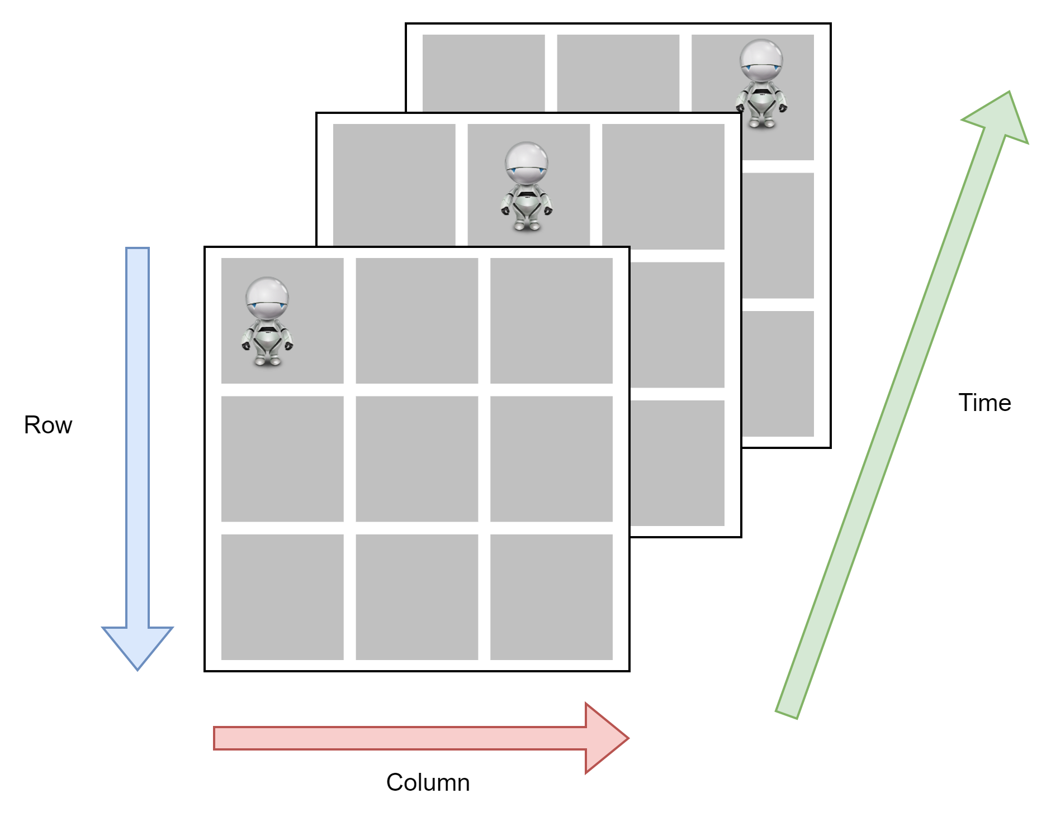
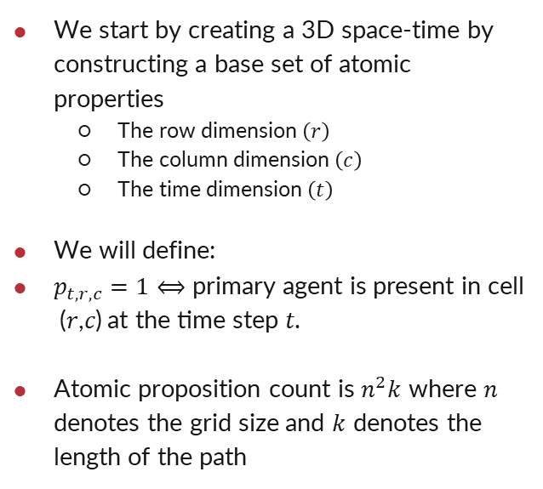
Algorithm - Base
We start by creating a 3D space-time by constructing a base set of atomic properties
The row dimension $\left(r\right)$
The column dimension $\left(c\right)$
The time dimension $\left(t\right)$
We will define:
$p_{t,r,c}=1⟺\text{primary} \text{agent} \text{is} \text{present} \text{in} \text{cell}\text{ (}\text{r}\text{,}\text{c}\text{)} \text{at} \text{the} \text{time} \text{step} \text{t}\text{.}$
Atomic proposition count is $n^{2}k$ where $n$ denotes the grid size and $k$ denotes the length of the path

Slide 17
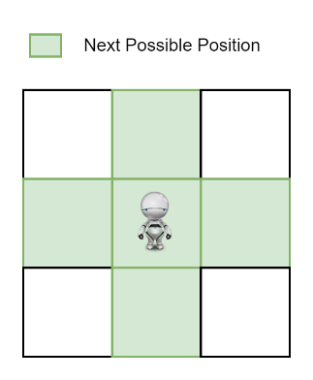
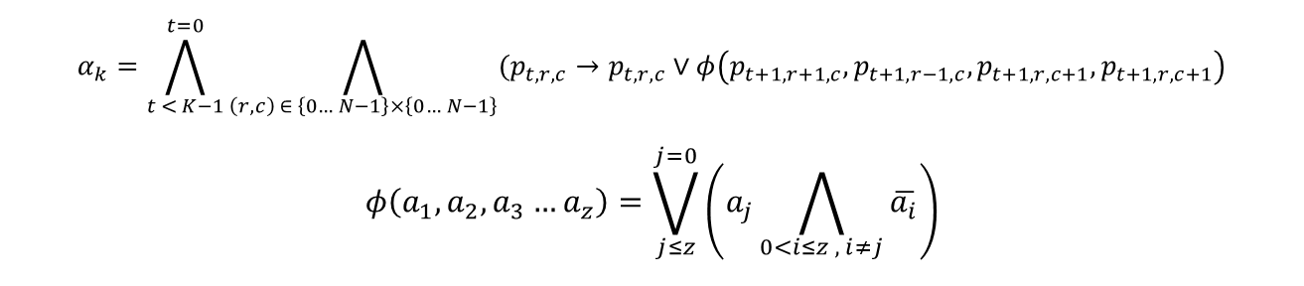
Algorithm – Valid Steps Constraint
Constraint Objective: Ensuring valid robot movement.
Robot can move only to adjacent cells or stay in current cell.
Ensures movement remains within defined grid boundaries.
$$α_{k}=\bigwedge_{t < K−1}^{t=0}{\bigwedge_{\left(r,c\right) ∈ \left\{0… N−1\right\}×\left\{0… N−1\right\}}{(p_{t,r,c}→p_{t,r,c}}}∨φ\left(p_{t+1,r+1,c},p_{t+1,r−1,c},p_{t+1,r,c+1},p_{t+1,r,c+1}\right)$$
$$φ\left(a_{1},a_{2},a_{3}…a_{z}\right)=\bigvee_{j≤z}^{j=0}{\left(a_{j}\bigwedge_{0<i≤z , i≠j}{\overline{a_{i}}}\right)}$$

Slide 18
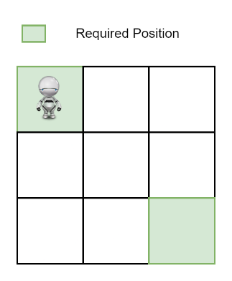
Algorithm – Path Finding Constraint
Constraint Objective: Constructing a path for the robot from initial to final state with valid movement.
$$α_{i}=p_{0,0,0}$$
$$α_{f}=p_{N−1,N−1,K−1}$$

Slide 19
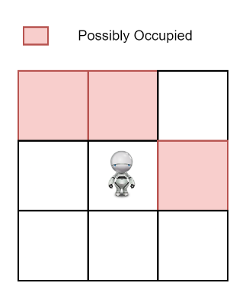

Algorithm – Safety Constraint
Objective: Ensuring safety by preventing robot collisions with obstacles from system M2.
Constraint Definition: Constraints prohibit robot occupancy in cells occupied by obstacles.
$$α_{s}=\bigwedge_{t < K−1}^{t=0}{\bigwedge_{\left(r,c\right) ∈ \left\{0… N−1\right\}×\left\{0… N−1\right\}}{\left(p_{t,r,c}→\overline{q_{t,r,c}}\right)}}$$
Where $q_{t,r,c}$ is the bad robot system occupancy indicator at $t, \left(r,c\right)$

Slide 20
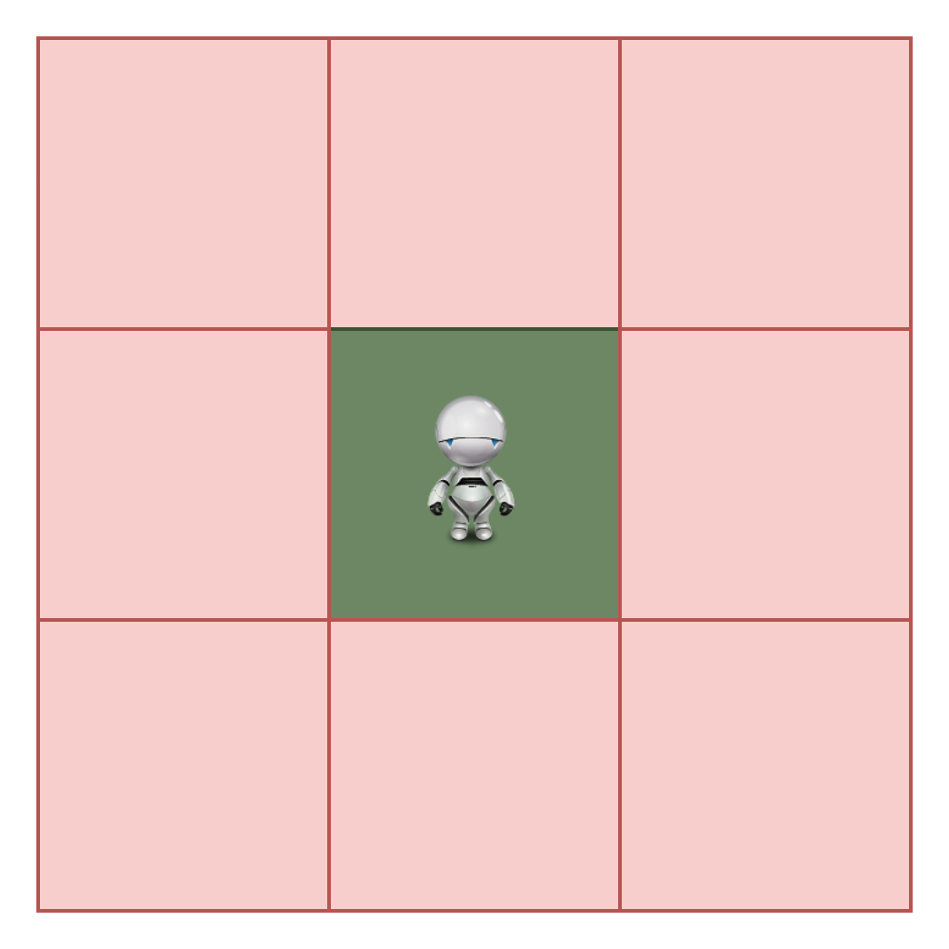

Algorithm – Single Path Constraint
Objective: Ensuring the good robot follows a single path, preventing multiple simultaneous movements..
$$α_{sp}=\bigwedge_{t < K−1}^{t=0}{\left(\sum_{\left(r,c\right) ∈ \left\{0… N−1\right\}×\left\{0… N−1\right\}}{p_{t,r,c}}≤1\right)}$$

Slide 21
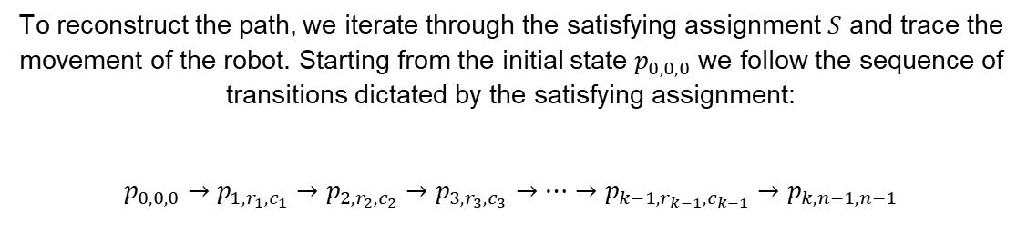
Algorithm – Solution Formula
Objective: Finding a path on the grid which is
Valid
Safe
Start to Finish
$$α=α_{i}∧α_{f}∧α_{k}∧α_{s}∧α_{sp}$$
To reconstruct the path, we iterate through the satisfying assignment $S$ and trace the movement of the robot. Starting from the initial state $p_{0,0,0}$ we follow the sequence of transitions dictated by the satisfying assignment:
$$p_{0,0,0}→p_{1,r_{1},c_{1}}→p_{2,r_{2},c_{2}}→p_{3,r_{3},c_{3}}→…→p_{k−1,r_{k−1},c_{k−1}}→p_{k,n−1,n−1}$$

Slide 22
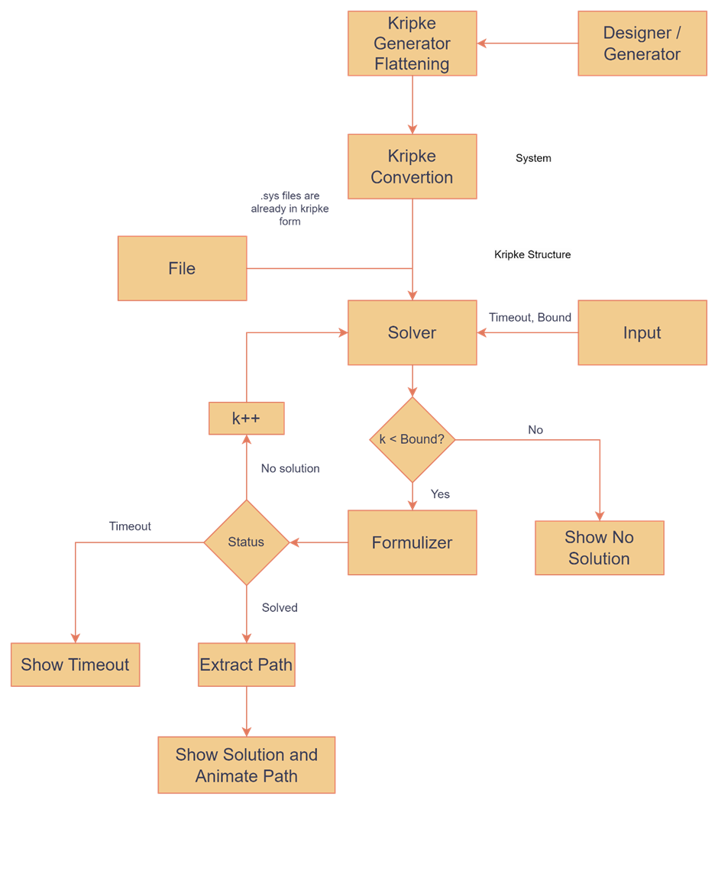
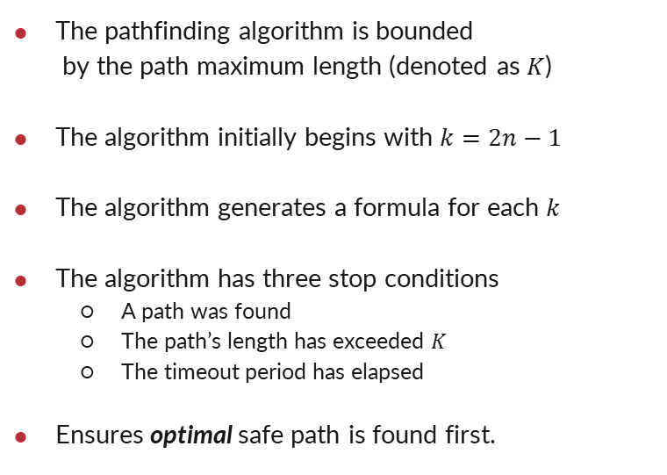
Algorithm – BMC
The pathfinding algorithm is bounded by the path maximum length (denoted as $K$)
The algorithm initially begins with $k=2n−1$
The algorithm generates a formula for each $k$
The algorithm has three stop conditions
A path was found
The path’s length has exceeded $K$
The timeout period has elapsed
Ensures optimal safe path is found first.

Slide 23
05
Analysis and Benchmarking

Slide 24
Counter Agents
Grid Size = 15, Radius = 10, Stay Chance = 0.1

Slide 25
Stray Radius
Grid Size = 15, Counter = 3, Stay Chance = 0.1

Slide 26
Stay Chance
Grid Size = 15, Counter = 3, Radius = 10

Slide 27
Path Length (Bound)
Grid Size = 15, Counter = 3, Radius = 10, Stay Chance = 0.1

Slide 28
Grid Size
Counter = 3, Radius = 10, Stay Chance = 0.1

Slide 29
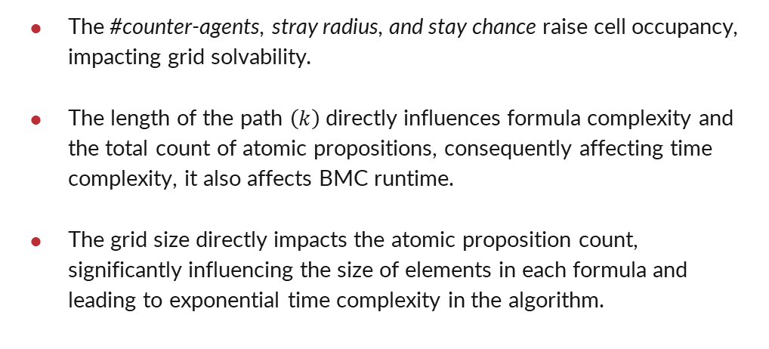
Conclusions
The #counter-agents, stray radius, and stay chance raise cell occupancy, impacting grid solvability.
The length of the path $\left(k\right)$directly influences formula complexity and the total count of atomic propositions, consequently affecting time complexity, it also affects BMC runtime.
The grid size directly impacts the atomic proposition count, significantly influencing the size of elements in each formula and leading to exponential time complexity in the algorithm.

Slide 30
Thanks!

